Slide 1

Array Basics in C++
By Varun Bansal

Slide 2

What and Why Variables

Slide 3


Let’s say we have to use a value again and again.

Slide 4
Basic Solution :
Use that value itself (567) again and again wherever it is required.

Slide 5

Not a good idea
Not very fast
We are not using our machines efficiently
If Value is changed we need to change at all the Places.
Very Tedious

Slide 6

Problems

Slide 7
Solution

Slide 8

Solutions
Declare a variable and use that wherever the value is required.

Slide 9

Arrays

Slide 10

Suppose the teacher wants to store the names of 100 Students.
Should she declare 100 variables??

Slide 11

Obviously No
Too time taking
Not a practical solution
What if count is in Millions.

Slide 12

Time Taking

Slide 13
Practical Solution
We must have some kind of mechanism where we need not to initialize the variables again and again.
Here Array comes into the Picture .

Slide 14
Array
We must have some kind of mechanism where we need not to initialize the variables again and again.
Here Array comes into the Picture .

Slide 15
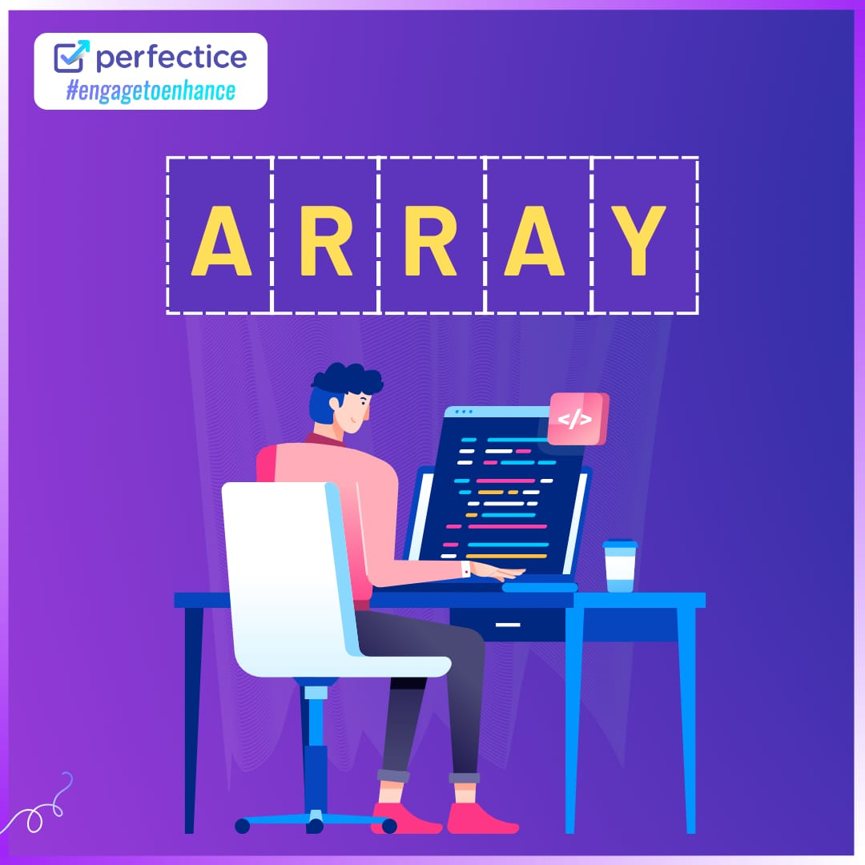

Slide 16
What exactly are Array?
How are they useful to us,
Come On Let’s Learn more about them.

Slide 17
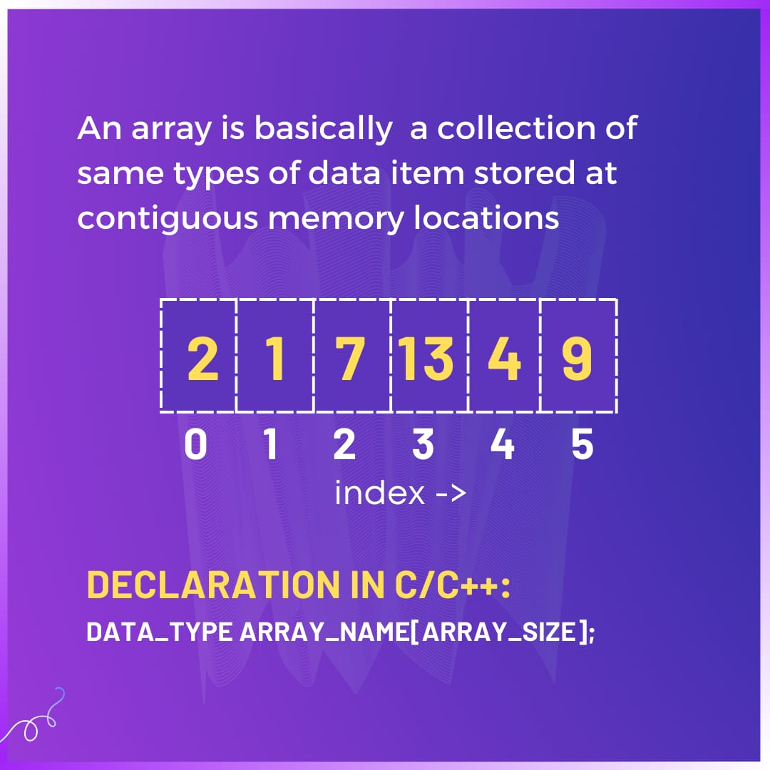

Slide 18
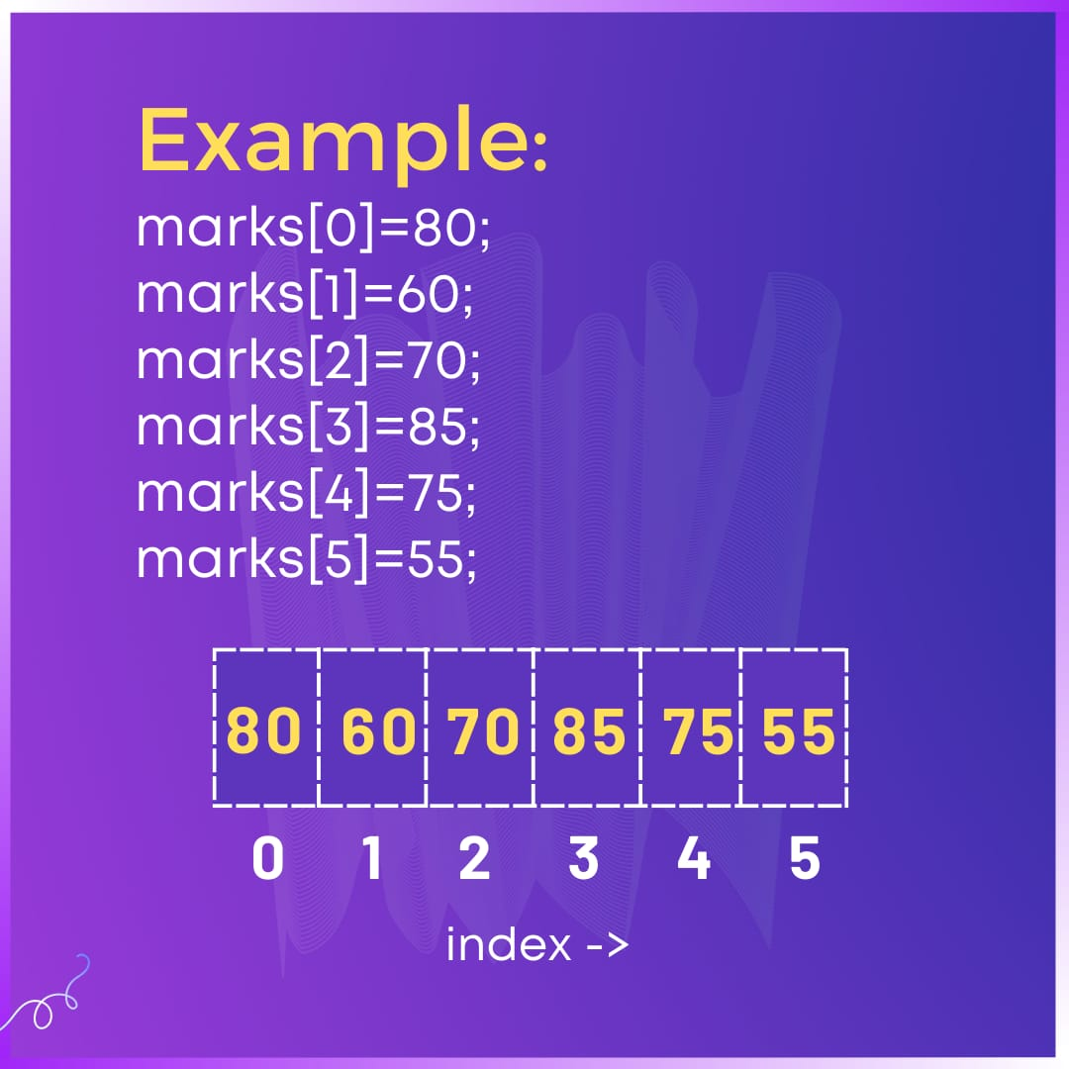

Slide 19

Let’s Jump to coding !
You can use any of the Compiler
CodeBlocks
DevC++
Vscode
Online compiler

Slide 20
Basic Codes
Taking the input from user and storing in the Array.
Displaying the values stored in Array.

Slide 21

Coding Time
Let’s practice some Questions

Slide 22
Practice questions
1).Finding the MAX and MIN Element in the Array.
2)Reverse the Array
3.)https://leetcode.com/problems/running-sum-of-1d-array/
Finding the running sum of array.
4) https://leetcode.com/problems/number-of-good-pairs/
Number of good pairs
5) https://leetcode.com/problems/shuffle-the-array/
Shuffle the Array

